Slide 1
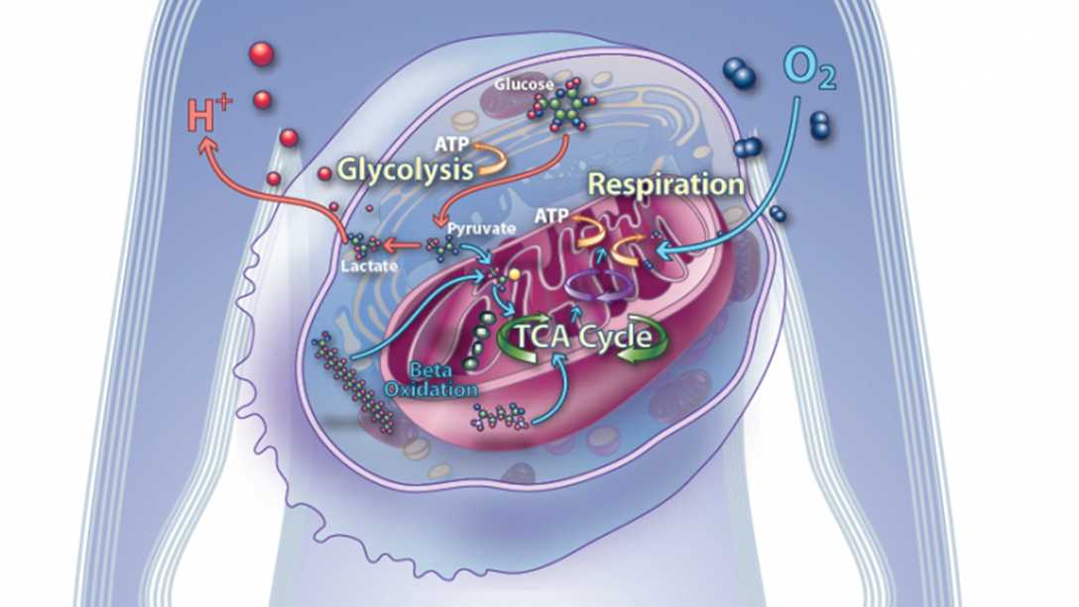
Metabolism
AEHBY ATAR Human Biology

Slide 2
Review
Describe the features of connective tissues.
Define organ, in terms of type of cells/tissues and functions.
Draw the rough endoplasmic reticulum and describe how its structure relates to its function.
Compare two different types of passive transport.

Slide 3
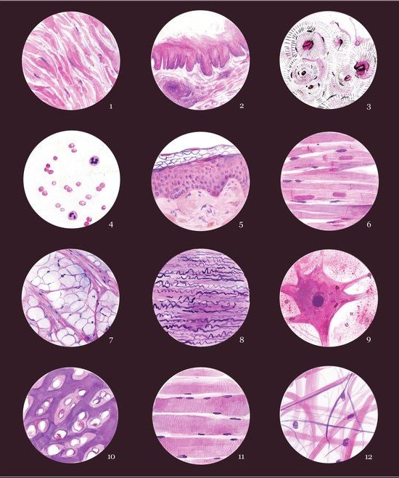
Review
5. Which type of tissue?

Slide 4
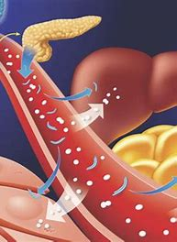
Learning Intentions
biochemical processes, including anabolic and catabolic reactions in the cell, are controlled in the presence of specific enzymes

Slide 5
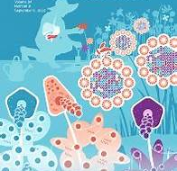
Success Criteria
Define metabolism
Compare anabolic and catabolic metabolic processes
Define enzyme
Describe two different models that explain enzyme function

Slide 6
Metabolism
the sum of the chemical reactions that take place within each cell of a living organism
provide energy for vital processes
synthesize (‘build’) new organic material

Slide 7
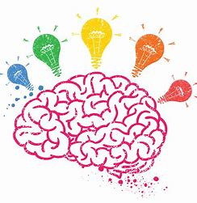
Which chemical reactions occur in cells?

Slide 8
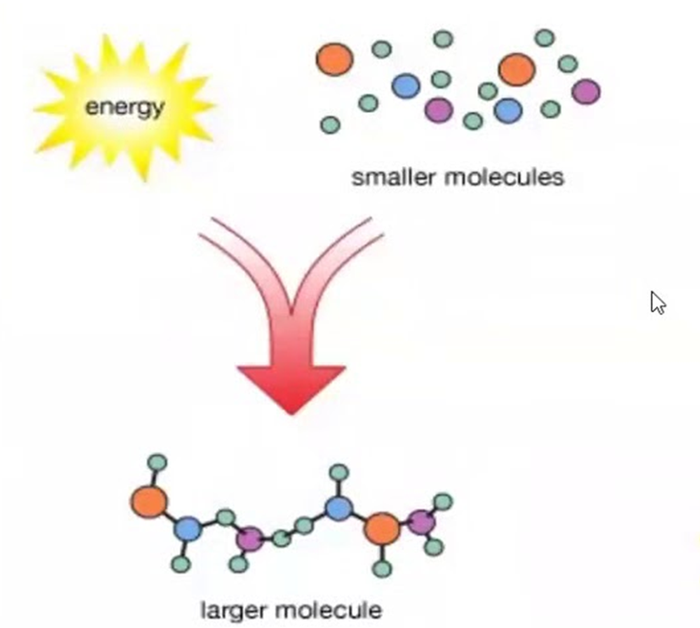
Anabolic reactions
Use energy to build larger molecules from smaller molecules,
eg building proteins from amino acids

Slide 9
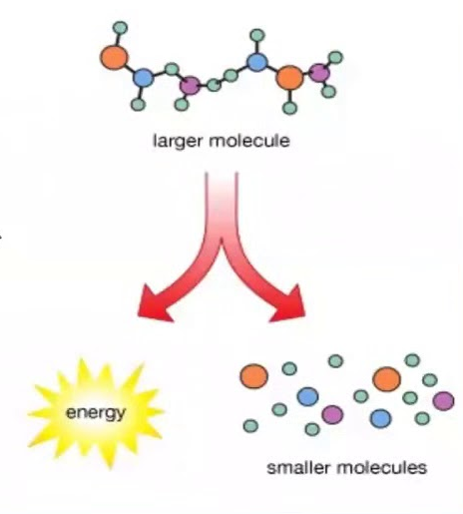
Catabolic reactions
Energy is released as large molecules are broken into smaller molecules,
eg cellular respiration

Slide 10
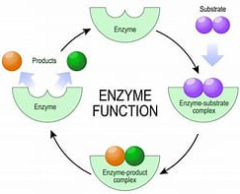
Enzymes
biological catalysts
made of protein
speed up reactions and allow them to happen at body temperature
are specific to a particular reaction

Slide 11


Slide 12
Questions
Give an example of an anabolic reaction in human cells.
Give an example of a catabolic reaction in human cells.
What would happen if anabolic and catabolic reactions were not balanced?
When would anabolism be greater than catabolism?
Why do we need enzymes for chemical reactions to happen in cells?
Explain the lock and key model.
Define substrate, active site, coenzyme and cofactor.

Slide 13
Success Criteria
Define metabolism
Compare anabolic and catabolic metabolic processes
Define enzyme
Describe two different models that explain enzyme function

